Slide 1
Task Manager with Progress Tracker
CAPSTONE PROJECT
Presented By:
Student Name :- Vaibhav Dnyaneshwar Patil
College Name :- GF’s Godavari College of Engineering, Jalgaon
Department :- Computer Engineering

Slide 2
OUTLINE
Problem Statement (Should not include solution)
System Development Approach (Technology Used)
Algorithm & Deployment (Step by Step Procedure)
Result
Conclusion
Future Scope(Optional)
References

Slide 3
Problem Statement
Many users struggle with managing daily tasks and tracking progress.
Existing tools are often complex, costly, or lack proper visualization.
There is a need for a simple, lightweight, and user-friendly task manager that allows adding, editing, completing, and tracking tasks with visual progress.

Slide 4
System Approach
Frontend Technologies:
HTML5 – structure of the app
CSS3 – styling and responsive layouts
JavaScript – dynamic interactivity (add/edit/delete tasks, filters, progress bar)
Storage:
Local Storage for saving tasks persistently
Design Approach:
Clean, simple, mobile-responsive interface with modular separation of HTML, CSS, and JS

Slide 5
Algorithm & Deployment
Task Creation: User inputs title, description, due date, and priority.
Task Management: User can edit, mark complete, or delete tasks.
Progress Tracking: Overall progress visualized with a progress bar and statistics.
Filtering: Tasks can be filtered by Active, Completed, Due Today, or High Priority.
Testing: Ensure cross-browser compatibility and responsive design.
Deployment: Host project using GitHub Pages for easy access.

Slide 6
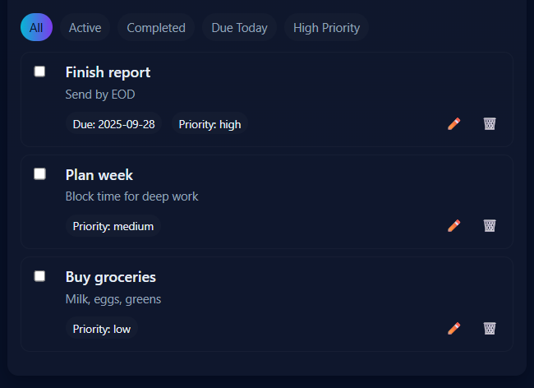
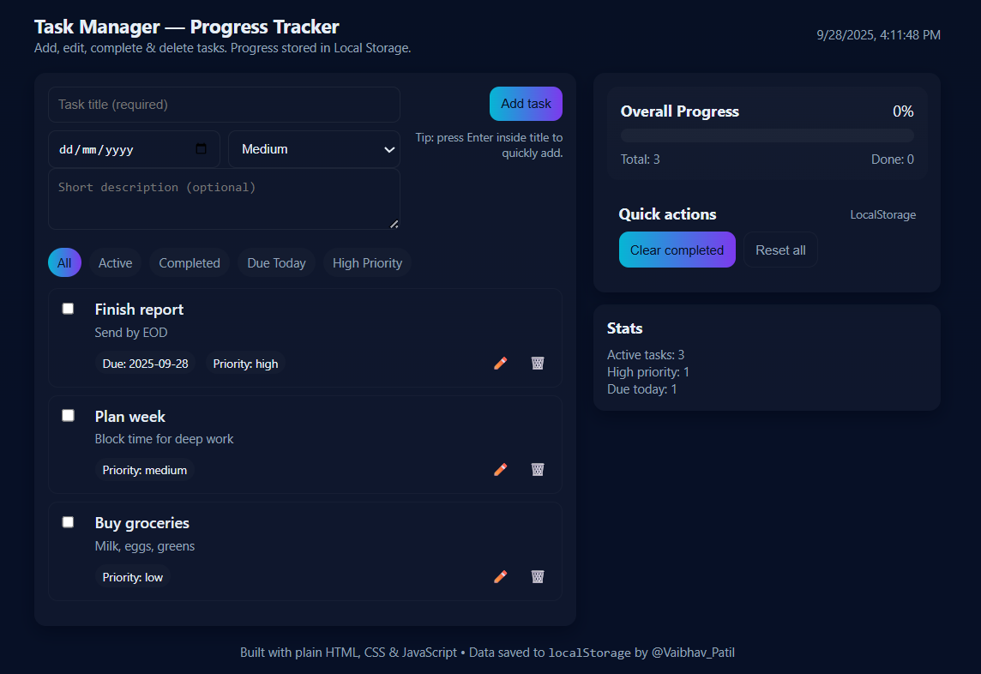
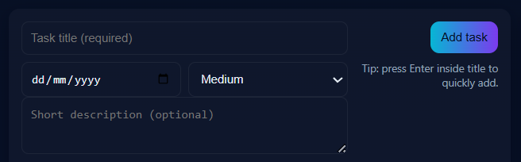
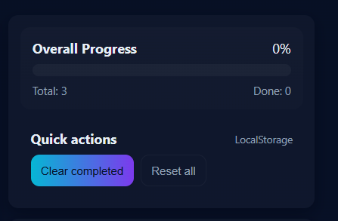
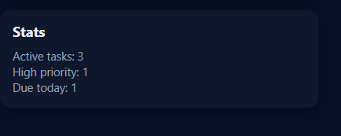
Result

Slide 7
GITHUB AND DEPLOYMNET LINK
Attach your Github Link : https://github.com/VAIBHAV1516N/FWD-Intern-by-EDUNET_FOUNDATION.git
Deployment link: https://vaibhav1516n.github.io/FWD-Intern-by-EDUNET_FOUNDATION/

Slide 8
Conclusion
Provides a lightweight and effective solution for daily task management.
Helps users improve productivity and time management.
Visual progress tracking makes monitoring tasks easy and motivating.

Slide 9
Future scope(Optional)
Add reminders and notifications
Sync tasks across multiple devices with cloud storage
Calendar integration for scheduling
AI-based task prioritization and productivity insights

Slide 10
References
MDN Web Docs (HTML, CSS, JavaScript)
W3Schools tutorials
GitHub Pages documentation for deployment
Stack Overflow for troubleshooting

Slide 11
THANK YOU

